Slide 1
Bitfields and Floating-point numbers
CS 0447
Jarrett Billingsley

Slide 2
Class announcements
there are PLENTY of exercises that go with this lecture. do em.
and a couple Java examples on the materials page!
today we’ll see more practical applications of the bitwise operations that we learned about last time
and find out what the hell is up with floats
we’ll start with a motivating example, then learn the technique to solve it, then come back to that example!

Slide 3
Floating-point numbers

Slide 4
Another world
to represent numbers with places after the decimal (or binary) point…
+1.5
-0.000000000001
+9.581977
-3.994
+99030000000.0
there is a lot of variation in the magnitude of these numbers, but we always have to keep track of three things:
1. the sign
2. the digits
fortunately, scientists have been doing this for a while, and have a useful system for this.
3. the position of the decimal point within the digits
Notes:
123, 12.3, and 1.23 all have the same digits, right? the only difference is where the decimal point is located.
and really, that’s why we call “floating point” “floating point.” because the point “floats around” to any position.

Slide 5
Scientific notation refresher
scientific notation expresses numbers like so:
+6.022 × 10²³
sign
exponent
(i.e. position of point)
significand
there is exactly one non-zero digit before the decimal point.
negative exponents are used for numbers smaller than 1.
(with one exception: the number 0)
when you get the reciprocal…
$\frac{1}{x ×{ 10}^{y}}$ = $\frac{1}{x} × {10}^{−y}$
Notes:
- what was this called? the Avocado Number?
- remember… 1/8 is not 8.

Slide 6
How about in binary?
well, computers don’t use base 10. but that’s okay. scientific notation works just as well in base 2.
(but the below writes exponents in base-10 for clarity)
+10010101 =
-0.00101 =
-1001000000000000 =
+1.0010101 × 2⁺⁷
-1.01 × 2⁻³
-1.001 × 2⁺¹⁵
what do you notice about the digit before the binary point?
Notes:
since the rule is “one nonzero digit before the point”, in binary, which is the only digit that’s allowed to be there?

Slide 7
But how do we represent it space-efficiently?
we could represent floats poorly by doing something like…
class BadFloat {
boolean sign;
int significand;
int exponent;
}
each int field takes up 4 bytes; the boolean field takes up 1; and there are hidden fields and alignment involved, so…
one instance of this class may take up 16 to 24 bytes. that’s awful.
in contrast, a float takes up only 4 bytes. but how?
float f = -1.5;

Slide 8
Bitfields

Slide 9
How many bits do you really need?
remember: with n bits we can represent 2^{n} different values.
for the sign… how many bits would it really take to represent it?
just 1 bit, right? 0 for positive, 1 for negative, like integers.
for the exponent… what are the biggest and smallest numbers are you likely to encounter on a regular basis?
the volume of the visible universe is on the order of 2²⁶⁵ m³.
most useful numbers are way smaller, so maybe exponents in the range 2⁻¹²⁸ to 2⁺¹²⁷ are sufficient. how many bits for that?
then, for the significand, uh… well… um…
really, it’s a matter of how much precision you want.
more bits = more precision.
well, let’s target 32 bits total, so 32 - 8 - 1 = 23 bits for the significand.
Notes:
- the visible universe is about 10^80 cubic meters, and the base-2 logarithm of 10^80 is about 265. hence, 2^265.

Slide 10
Taking shape
think back to when we looked at bitsets last time. we encoded multiple separate 1-bit values within one integer.
what if we extended that concept to multiple-bit values?
00111111100000000000000000000000
0
01111111
00000000000000000000000
these are the exponent…
…and these are the significand.
let’s make this the sign bit.
there! just 32 bits, or 4 bytes, for all three values. this is a bitfield.
now think about the bitwise operations from last time. what operations move bits left and right? which operation turns on bits? which turns them off?
Notes:
left and right shift might be useful for, say, moving the exponent to the right so we can “extract” it somehow.
OR turns bits on, by ORing a bit with 1.
AND turns bits off, by ANDing a bit with 0.

Slide 11
Space efficiency isn’t just for fun
why use one integer instead of three? because it's smaller.
smaller data…
takes up less space in memory
takes up less space in cache
extremely important thing in modern CPUs that we talk about in 1541
is faster to move between memory and the CPU
or between the CPU and anything else
is faster to transfer across the internet and other networks

Slide 12
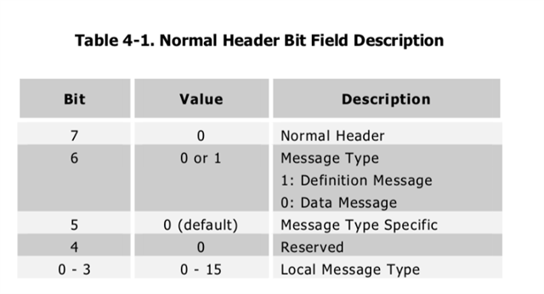
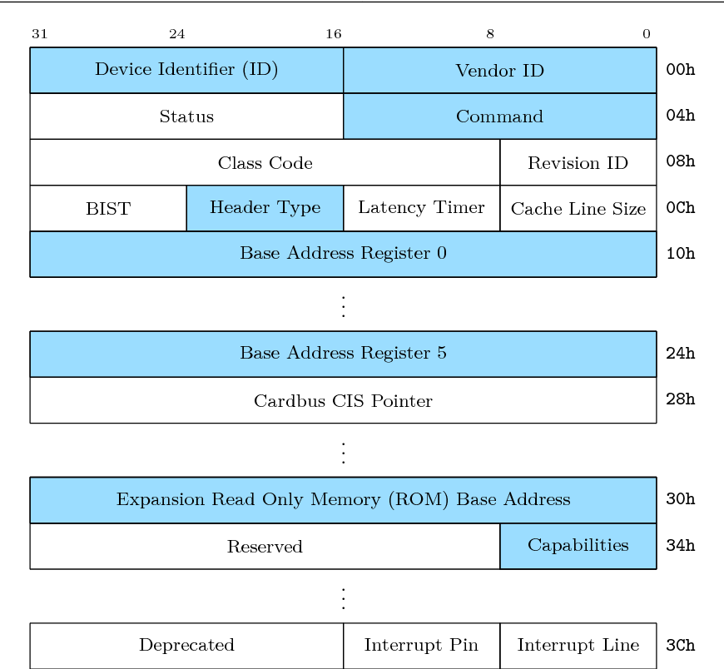
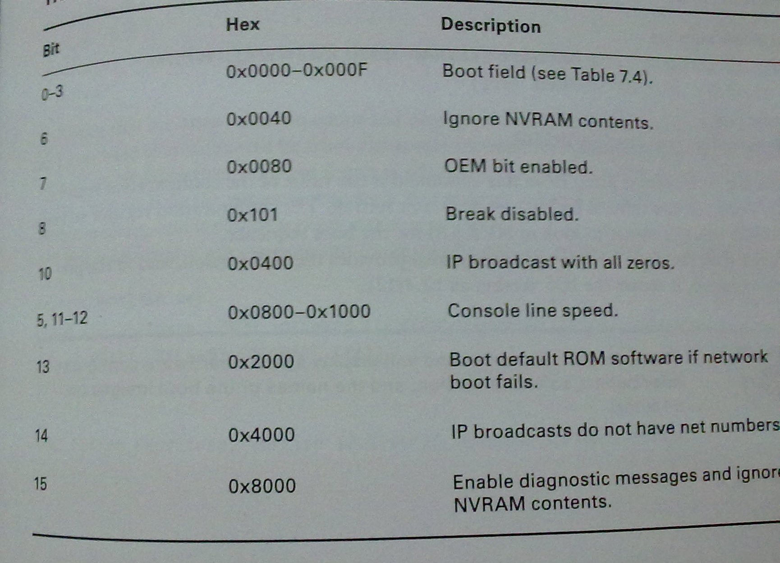
And they're everywhere.
we use bitfields a lot.
binary file formats…
controlling hardware…
CPU machine code…
31 | 26 | 25 | 21 | 20 | 16 | 15 | 11 | 10 | 6 | 5 | 0
opcode |  | rs |  | rt |  | rd |  | shamt |  | funct
31 | 26 | 25 | 21 | 20 | 16 | 15 | 0
opcode |  | rs |  | rt |  | immediate
31 | 26 | 25 |  | 0
opcode |  | target
Notes:
- maybe you took 447 before and learned to encode/decode MIPS instructions.
- that's just one example of bitfields, so I'm teaching you the general technique instead.

Slide 13
Masking

Slide 14
Masquerade
we saw last time that bitwise AND could “turn off” bits while leaving others untouched, which let us “filter out” unwanted bits.
a mask is a specially-constructed value that has:
1s in the bits that we want to keep
0s in the bits that we want to discard
what if I want to isolate the lowest 5 bits of a number?
00000000000011111100100001001011
&
00000000000000000000000000011111
00000000000000000000000000001011
this is masking: ANDing a value with a mask to isolate some bits by turning off the others.
to isolate the lowest n bits, AND with 2^{n}-1. or,
bits & ((1 << n) – 1)
Notes:
2^5 – 1 = 31, or in binary, 11111
remember that (1 << n) = 1 * 2^n.

Slide 15
Another way to make masks
what if you don't waaaaaanna calculate 2^{n}-1?
think of it this way: to extract n bits, you need n 1s (in binary).
so write that many 1s, then convert to hex, which is easy.
n | Binary Mask | Hex Mask
1 | 1 | 0x1
notice the pattern in the hex versions. 1, 3, 7, F… and then it repeats.
2 | 11
0x3
3 | 111
0x7
I don't even think of the binary anymore. I just go: "13 bits? 0xFFF gives me 12, then put 1 in front of that… 0x1FFF."
4 | 1111
0xF
5 | 1 1111
0x1F
6 | 11 1111
0x3F
7 | 111 1111
0x7F
Notes:
- so for an n-bit mask in hex, you will have n/4 Fs at the end, with a 1, 3, 7, or F before them. always!

Slide 16
Masking can also do modulo!
something arithmetically useful that masking can do:
&
we’re kind of truncating this value to 3 bits, right? and truncation performs modular arithmetic… so this does 53 % 8.
00110101
00000111
00000101
= 53
= 8 - 1
= 5
so, if you want to modulo by a power of 2, AND with that power of 2 minus 1.
or, a % 2^{n} == a & (2^{n}-1)
note that this only works for powers of 2! you cannot do x & 49 to do x % 50 because 50 is not a power of 2.
Notes:
- this will “work” on negative numbers, as long as you are using the convention that the remainder of a division should always be positive, but not everyone expects that! for example, one possible solution to -10 ÷ 8 is -2 R 6, and -10 & 7 == 6. notice I said “one possible” – there are multiple solutions to integer division problems. lol.
- it’s kind of related to how shifting right does division by powers of 2… shifting right throws away the bits on the right side, but this keeps the bits on the right side and throws away the bits on the left.
- this works on decimal numbers, too. if you write 1234 and erase 12, you are left with 34. That is 1234 % 100.

Slide 17
Decoding and encoding bitfields

Slide 18
Bitfield specifications
when you want to use a bitfield, you must have a specification for the positions and sizes of each value (each field).
they typically look something like this:
the lower (right) bit number of each field is its position.
31 | 26 | 25 | 21 | 20 | 16 | 15 | 11 | 10 | 6 | 5 | 0
opcode |  | rs |  | rt |  | rd |  | shamt |  | funct
the position is how far you have to shift for that field.
you also need to know the size of the field (in bits).
from the size, you can compute the mask for each field.
Notes:
for the size: remember the inclusive-both-ends-range size? [lo, hi] has (hi - lo + 1) items.
here, opcode/funct are 6 bits; rs/rt/rd/shamt are 5 bits. you figure out the masks! but notice that the mask is just a function of the size – all the 5-bit fields have the same mask, and both the 6-bit fields have the same mask.

Slide 19
Shift'n'mask
here's the specification for our floats:
31 | 30 | 23 | 22 | 0
S | exponent |  | significand?
to extract one field from a bitfield:
1. shift right by its position
2. isolate the lower size bits with a mask
sign = (f >> ) &
31
0x1
exponent = (f >> ) &
23
0xFF
significand = (f >> ) &
0
0x7FFFFF
(shifting right by 0 is optional.)
Notes:
- …… well it’s not actually the whole significand, as we’ll see shortly.

Slide 20
Two bitwise operations down, two to go…
what's the opposite of right shift?
what's the "opposite" of AND?
31 | 30 | 23 | 22 | 0
S | exponent |  | significand
to encode multiple values into a bitfield:
1. shift each field left by its position
2. OR the resulting shifted values together
f = (sign << ) |
(exponent << ) |
(significand << );
31
23
let’s look at Bitfields.java!
0
(shifting left by 0 is optional.)

Slide 21
IEEE 754

Slide 22
IEEE 754
this is the standard for floats that all CPUs and software now use.
it defines single- and double-precision float formats*.
31 | 30 | 23 | 22 | 0
S | exponent |  | fraction
float
63 | 62 | 52 | 51 | 0
S | exponent |  | fraction
double
the sign and fraction go together. and just like ints, the MSB is the sign.
let's ignore the exponent for now cause it's... weird……………
Notes:
thank god, cause apparently before IEEE 754, it was a huge mess. apparently. I wasn't around for it.
but basically every computer and sometimes every program invented their own ways of representing floating-point numbers and none of them agreed and code that worked fine on one machine would give totally incorrect results on another and aaaaaaaaaaaa!
* …among several others. go look it up if you're curious.

Slide 23
How the sign and fraction fields work
floats don't use 2's complement. they use sign-magnitude.
do you remember the disadvantages and how to negate? (let’s look at FloatBits.java)
the sign goes in the sign field. duh.
the bits after the binary point go in the fraction field, left-aligned.
+1.0010101 × 2⁺⁷
+1.0010101 × 2⁺⁷
31 | 30 | 23 | 22 | 0
0 |  |  | 00000000000000000000000
31 | 30 | 23 | 22 | 0
0 |  |  | 00101010000000000000000
but what about the bit before the binary point?
it's always 1, so we don't store it!
just pretend there's a 1. before the fraction. except for 0.
Notes:
- S-M has two zeroes and more complex/difficult arithmetic.
- negating sign-magnitude is easy: flip the sign bit!

Slide 24
The exponent
the exponent is a completely separate number.
it is also a baffling number. they did this for Sorting Reasons™️.
This…
is stored as…
×2⁰
127
this is biased notation.
×2⁺⁷
134
to get the number you put into the exponent field, you add a bias constant.
×2⁻¹²⁶
1
for single-precision floats, that's 127.
×2⁺¹²⁷
254
Notes:
- using biased (or excess-K) notation for the exponent makes it easier to do comparisons/sorts.
- it also makes it possible to compare/sort floats using integer comparisons. which is neat? hey, it's faster.

Slide 25
The dark side of the floats
because the fractional places of floats are powers of 2…
some very common fractions behave differently than you expect.
System.out.println(0.1 + 0.1 + 0.1);
=> 0.30000000000000004
this is not a bug. this is not a problem with Java. this happens in all programming languages, because they all use IEEE 754.
the problem is: 1/10 is an infinitely repeating decimal in binary!
0.1₁₀ = 0.000110011001100…₂
here is an important commandment:
THOU SHALT NEVER USE FLOATS FOR FINANCIAL CALCULATIONS.
Notes:
do you know how hard it is to put an overbar on text in powerpoint that renders correctly everywhere?
it’s hell. I’m in hell

Slide 26
Floats are not real numbers.
this problem with 0.1 is really a specific instance of a more general issue: computers cannot represent infinitely long numbers.
this means that nearly every floating-point number is just a rounded-off approximation of some real value!
therefore, every operation on floats rounds the result.
this has a really nasty consequence:
(a + b) + c may not be equal to a + (b + c)!
because (a + b) + c is really done as:
round(round(a + b) + c)
by the way the operation of that round() function depends on the value of a global register in the CPU and different pieces of code interacting may not expect this and it can wreak absolute havoc :))))))))))
Notes:
- infinitely long numbers would require infinite storage, which uh. doesn’t exist. :)

Slide 27
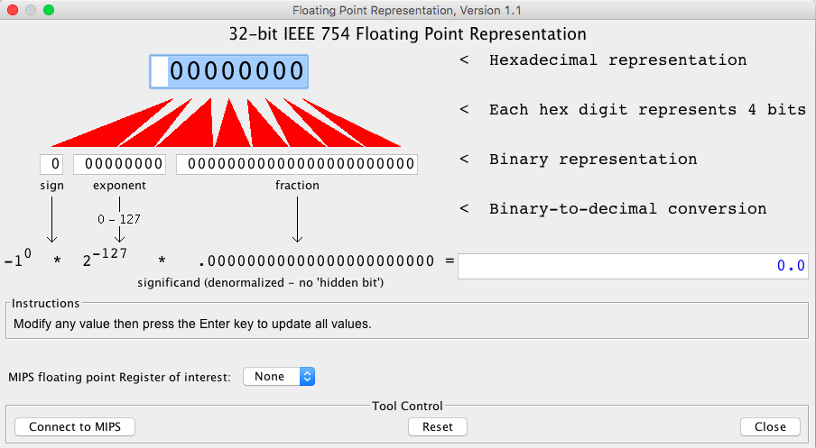
Something to check out in MARS
go to Tools > Floating Point Representation
it's an interactive thing! change any box and hit enter!

